Slide 1
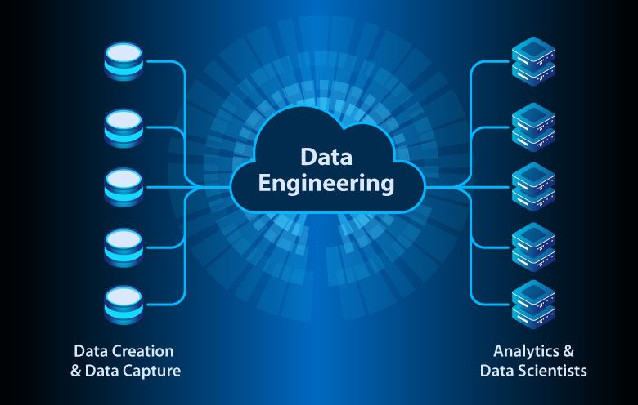
Data Engineering
The Fundamentals

Slide 2
What is a data engineer
A technical / IT savvy individual who prepares data for analytical or operational uses
Integrate, consolidate, cleanse and structure data.
Strong with programming, mainly in SQL and Python
Well versed in a variety of tools, particularly in the ETL, modelling and reporting space
Knowledgeable in data warehousing and data lakes
Well versed in database systems (both relational and NoSql)
Strong understanding of business intelligence and competent in some business intelligence platforms.
Some data engineers dabble in Machine learning, crossover with data science.
Good knowledge on data governance and management.
Understanding of data architecture
Data engineering is broad, most data engineers specialise in aspects of it.

Slide 3
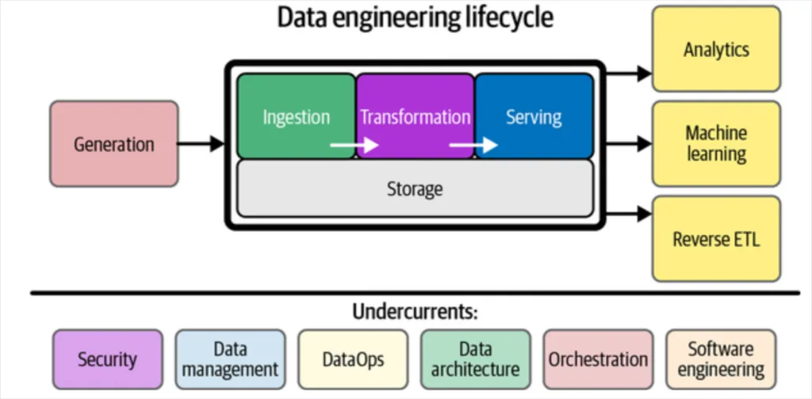
High level scope of the role

Slide 4
Ingestion
Data ingestion is the process of importing data from multiple different sources into a single space so that it can be worked on.
Generally split into two categories, Batch or real time.
Data ingestion often goes hand in hand with ETL:
Data can be cleansed / corrected during the ingestion process
Data can be restructured to fit into your target
Can be done in multiple ways, from replicating a full database to building a sophisticated data pipeline:
Database replication generally involves copying an entire database from the source into your target environment (data lake). This can either be done in a snapshot fashion or in near real time using database logs and CDC
Data pipelines are often used when something needs to happen to the data before landing it into the target, or when ingesting from less conventional sources

Slide 5
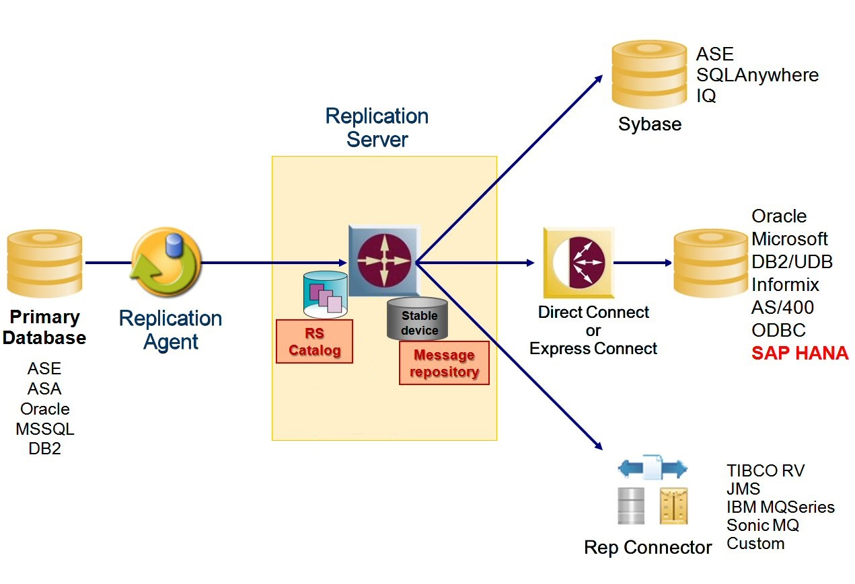
Example Replication Architecture

Slide 6
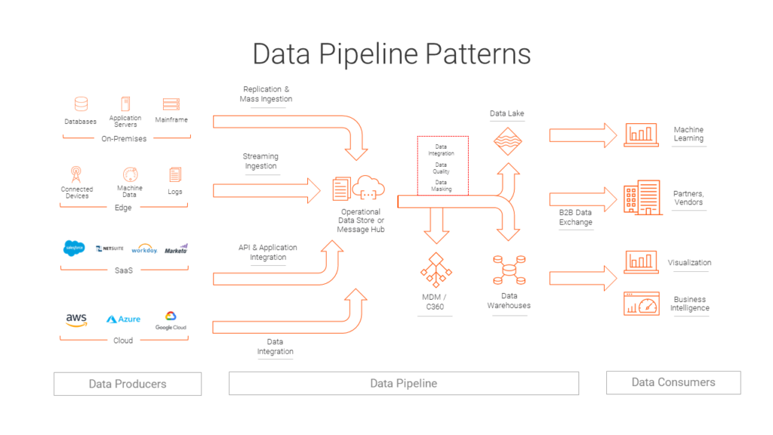
Data pipeline patterns

Slide 7
Transformation / Data Modelling
At a high level, data modelling is the process of mapping out the different parts of an information system and how they are connected.
Data models can exist at different levels, the conceptual, the logical and the physical.
Data modelling is most commonly used with a modelling technique / methodology
The most common methodologies are the relational model and dimensional modelling, however there are other niche methodologies out the like the data vault and the unified star schema methodology.
In this step, data is transformed by combining different sources of data together, applying business rules and shaping the data to meet business requirements.
The end goal of data modelling is to end up with data in a state in which business can use it, this normally results in a data warehouse or relational database.

Slide 8
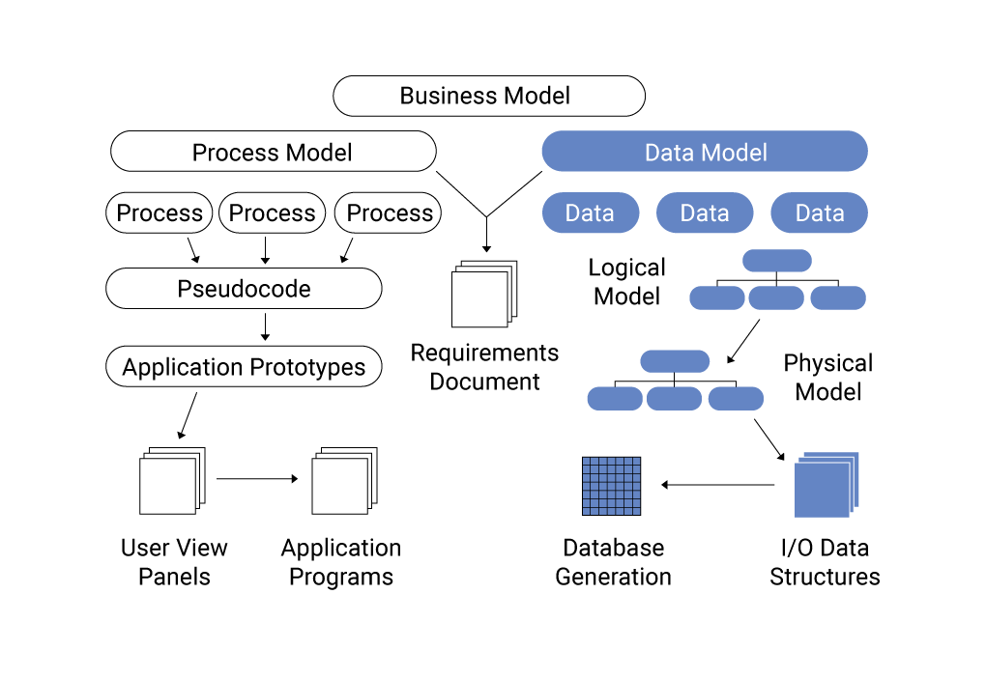
Example of the modelling process

Slide 9
Serving / Analytics / Reporting
The serving layer is where you expose your data to consumers/ analytics tools.
Data engineers normally perform the following actions in this layer:
Building of reports and dashboards in consumptions tools
Building / configuring rest api’s to expose the data
Building mechanisms to generate file based exports of the data.
Exposing the data to machine learning models.
And catering for the other interfacing requirements for the data

Slide 10
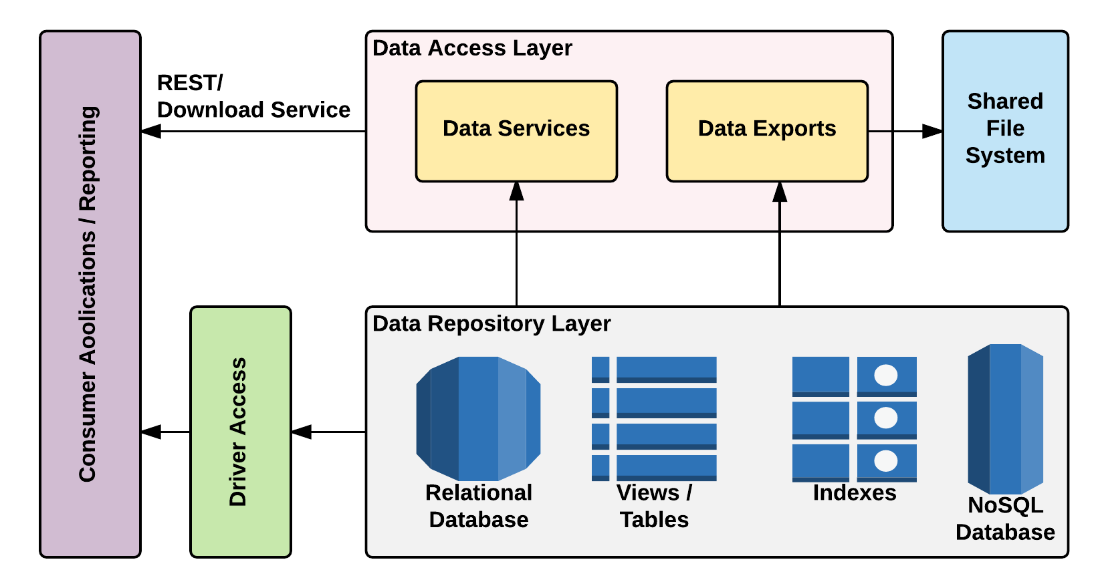
Serving data

Slide 11
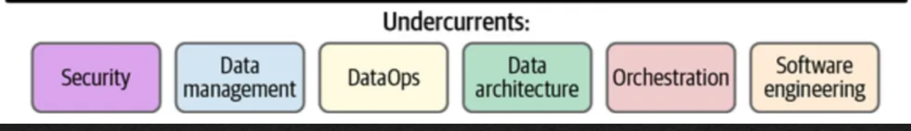
The Rest
Now that we have seen the 3 main components of data engineering, lets discuss the other components that tie this all up together

Slide 12
Questions?

